Slide 1
KAMUSHANOVSKOYE
deposit

Slide 2
Kyrgyzstan
Kamyshanovskoye Deposit
2025
General Data
2

Slide 3
SUMMARY 
Kamyshanovskoye Peat Uranium Deposit
Main Product – Uranium oxide (U₃O₈)
By-product – Scandium (Sc)
The uranium is located in peat deposits in the lowland area of the Chu River valley in Kyrgyzstan.
It was transported by underground waters from the foothills of the Tien Shan mountains and absorbed by the organic matter of the peat.
IMC Invest has been conducting systematic geological studies of the deposit since 2006. Over 1,500 drill holes have been completed, along with 140 trenches, and 6,200 samples have been collected.
The average thickness of the surface peat layer is 3.4 meters.
Average uranium grade is 300 ppm (0.03%), with a maximum of 5,960 ppm (0.59%).
Geological exploration, metallurgical, and technological testing have been conducted according to international standards.
Uranium reserves amount to 3,371.1 tonnes of U, approved on January 22, 2019 by the State Committee for Reserves (GKZ) in accordance with international standards (JORC Measured/Indicated – equivalent to C1 + C2), and resources of 2,600 tonnes (Target – P1). The deposit's potential growth is estimated at 4,000–5,000 tonnes of uranium.
In-situ leaching using bi-carbonate solutions has been tested and proven to be the most cost-effective method.
General Data
3

Slide 4
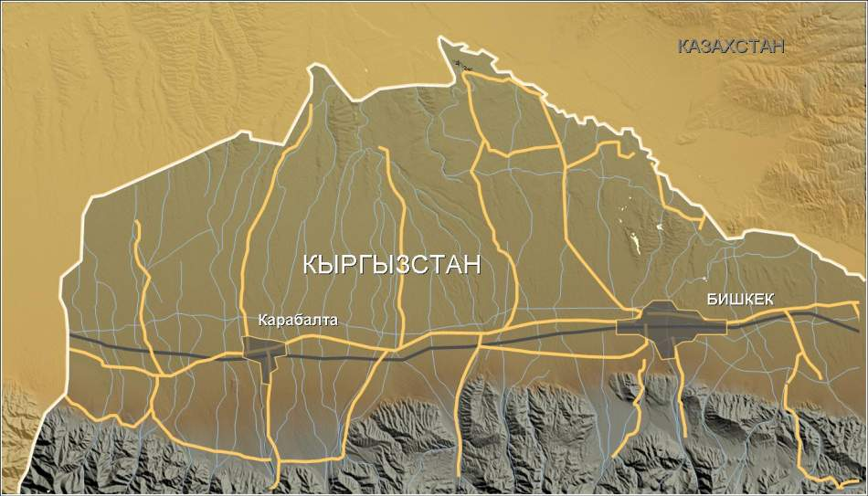
KAMUSHANOVSKOE INFRASTRUCTURE 
The deposit is located in the Chuy Region, 60 km from Bishkek and 70 km from the Karabalta Uranium Processing Plant (KGRK).
U
Kamushanovskyoe U deposit
70 km
60 km
IMC Bishkek
65 km
Karabalta U Processing Facility
General Data
4

Slide 5
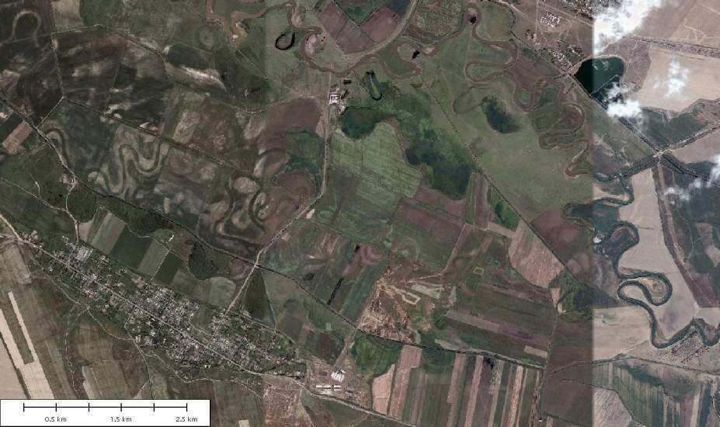
RESOURCES AND DEPOSIT POTENTIAL 
Measured/indicated
С1+С2
Полигон-2 по ПСВ
Inferred/target
С2+Р1
Exploration and Development
5

Slide 6
KAMUSHANOVSKOE RESOURCES ESTIMATION 
Uranium Resource Estimates by Year
Оранжевая линия- подсчет P. Jones, 2008
Красная линия подсчет Micromine, 2009
Author and Date | Soviet, 1962 | Snowden, 2007 | IMC Invest Phil Jones, Nov 2008 | Micromine Consulting Oct 2009 | Saint Barbara / Phil Jones, 2012
Resources category | P1 | Indicate/ Inferred | Measured/ Indicated | Measured/ Indicated | Measured/ Indic/Inferred
Resources, t | 165 | 776 | 1306 | 1775 | 5 543 000 lb (2 514 t)
Average grade, ppm | 440 | 420 | 380 | 340 | 320 peat 67 silt
Samples Quantity | 112 | 798 | 2135 | 4356 | 4935
Calculation Methodic | Geological Section | IDW² | IDW³ | Ordinary Kriging, IDW², IDW³ | Ordinary Kriging, IDW², IDW³
Зеленая линия подсчет
Snowden, 2007
Белая линия подсчет СССР, 1962
Exploration Stages
6

Slide 7
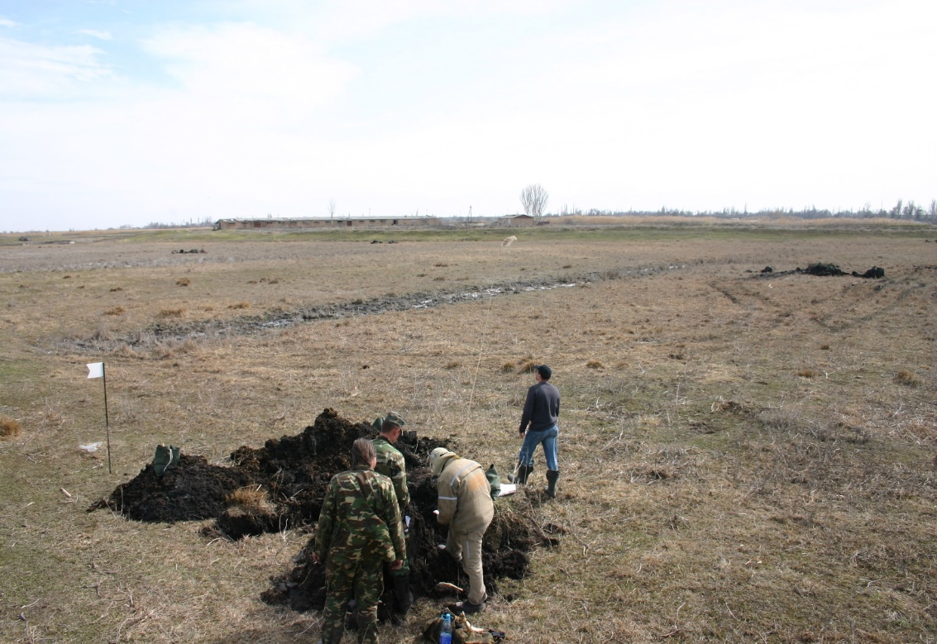
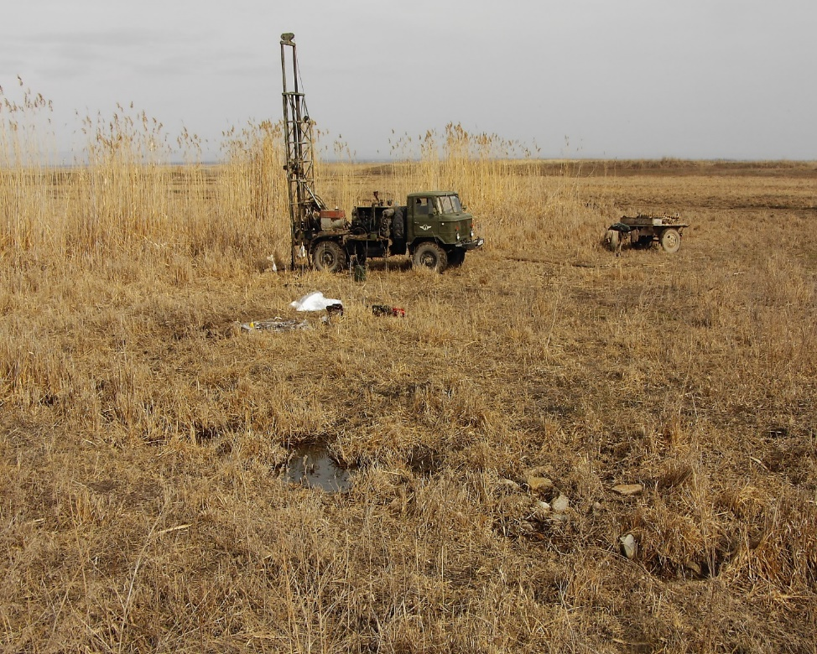
Sampling from test pits
Drilling
General Data
7

Slide 8
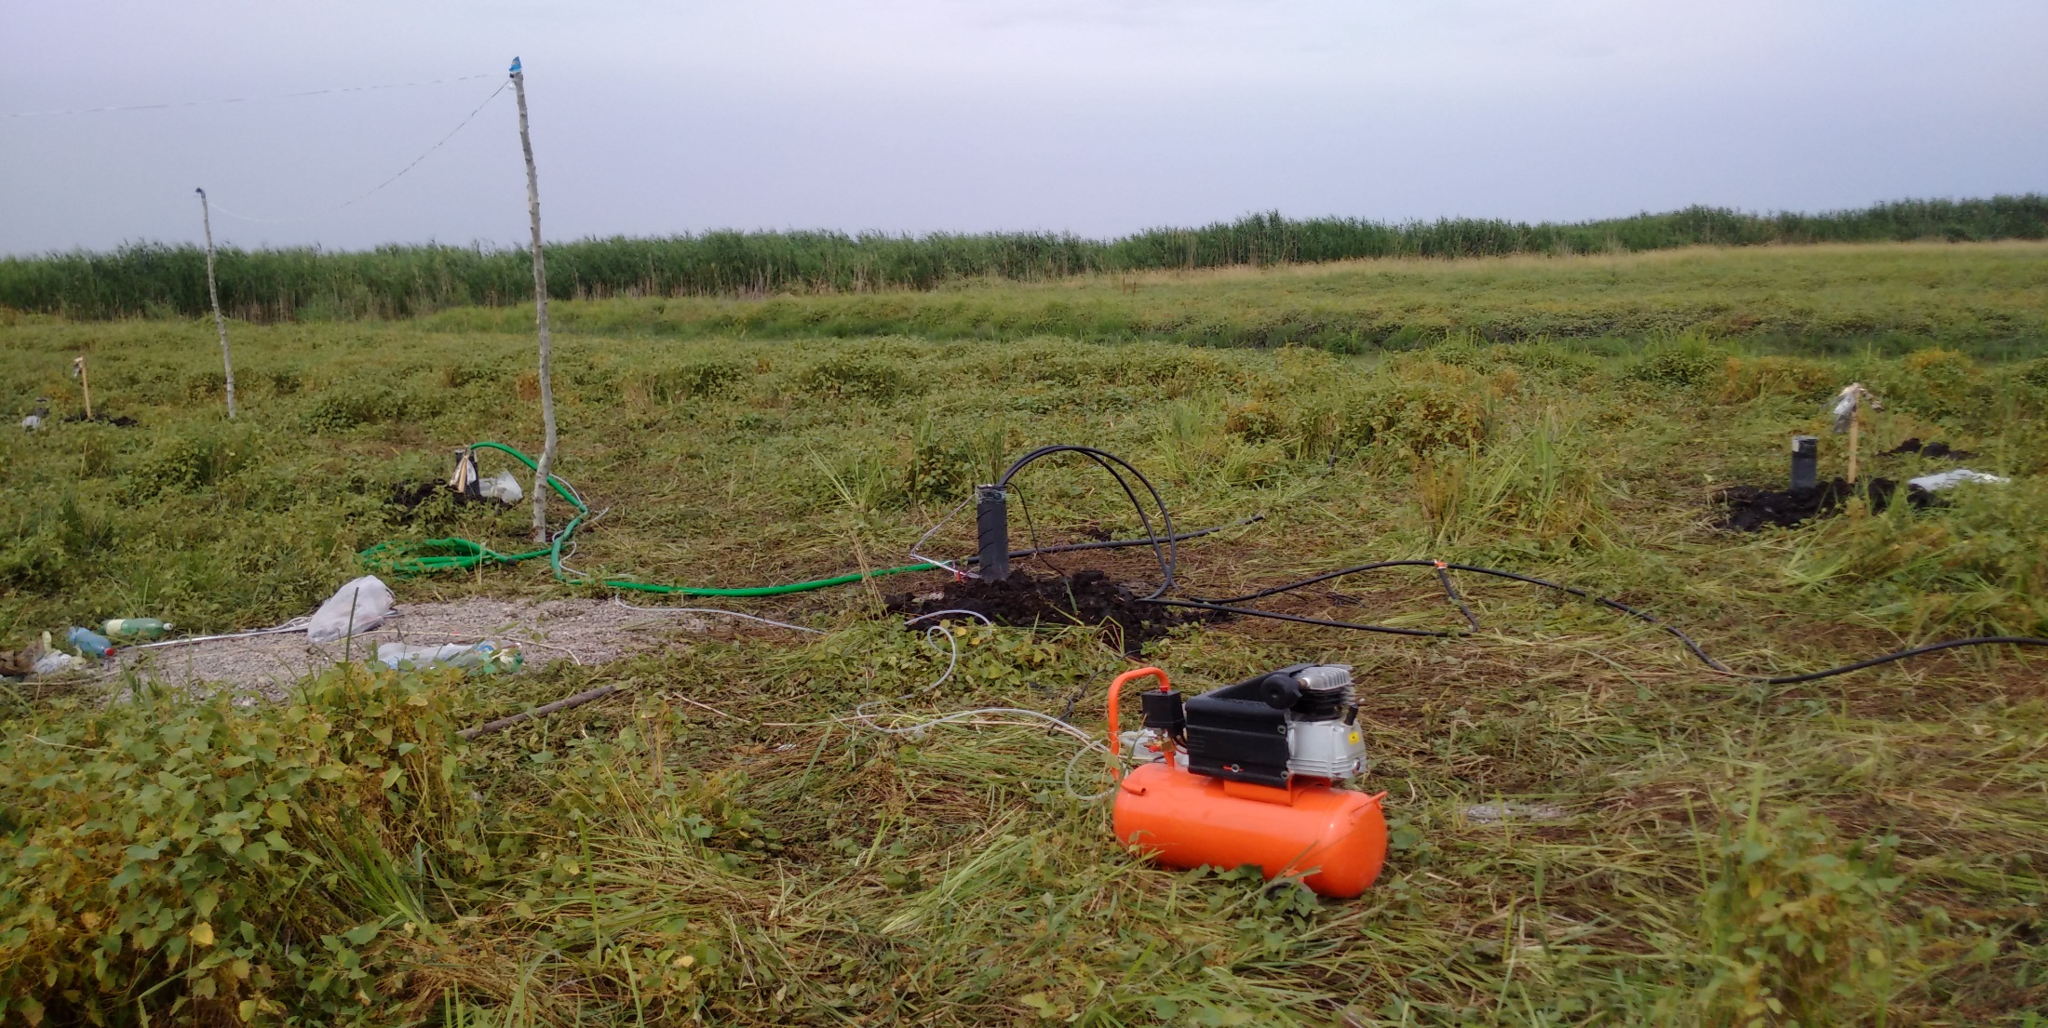
Test Site 1: Field Pilot of In-situ Leaching
June – October 2015
SUMMARY 
General Data
8

Slide 9
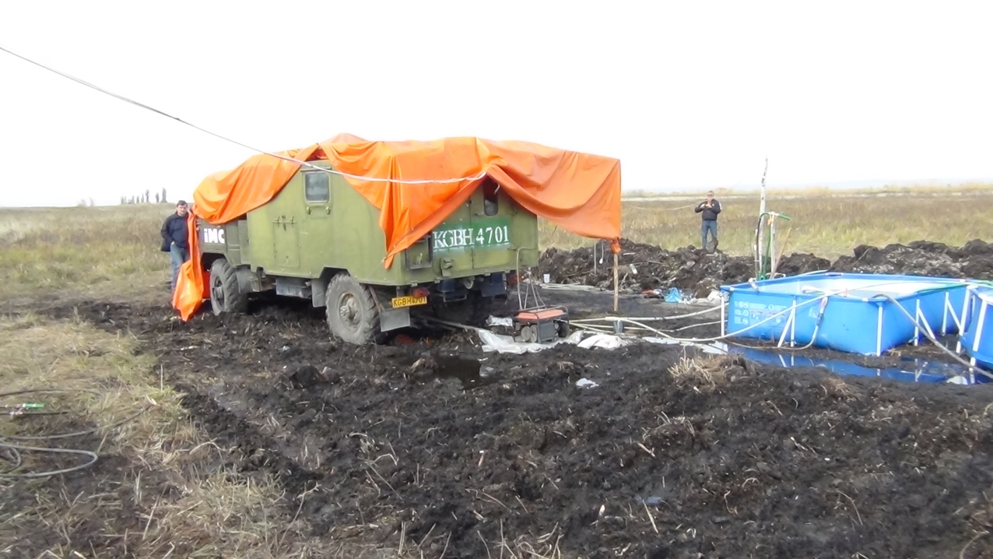
In-situ Leaching at Test Site 2
October – November 2015
General view, solution ponds.
General Data
9

Slide 10
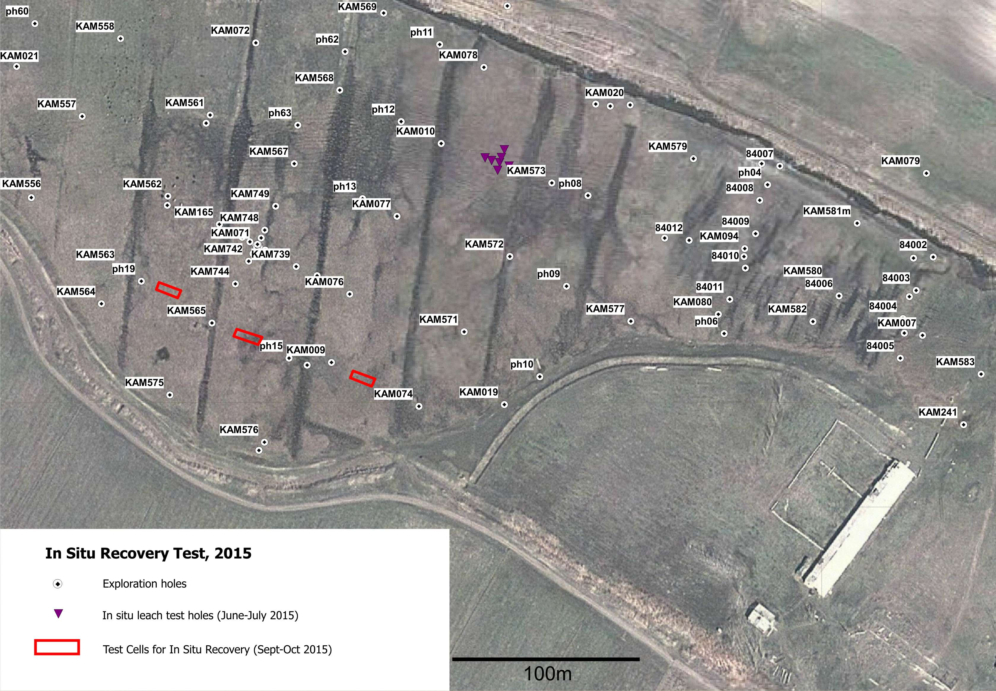
In-situ leaching site at the Kamyshanovskoye deposit, 2015
General Data
10

Slide 11
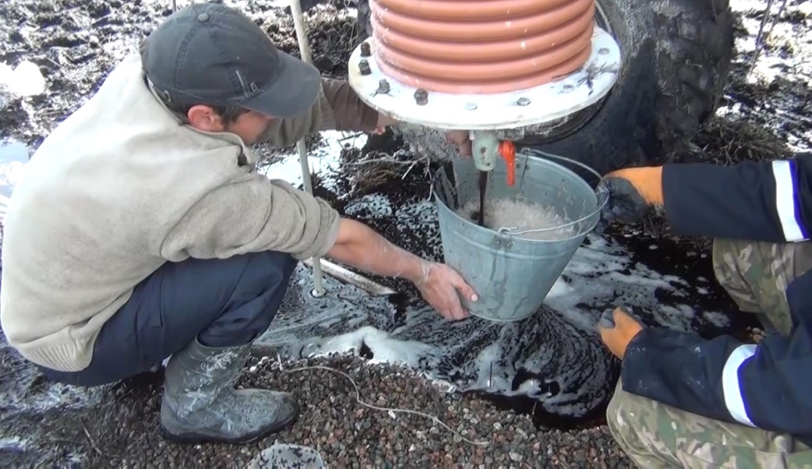
Recovery of Uranium-Enriched Anionite from the Sorption Column at Test Site 2
Based on the results of pilot-scale in-situ leaching operations at the Kamyshanovskoye deposit:
A sorption column with 42 kg of anionite absorbed 1.9 kg of uranium over 8 days.
General Data
11

Slide 12
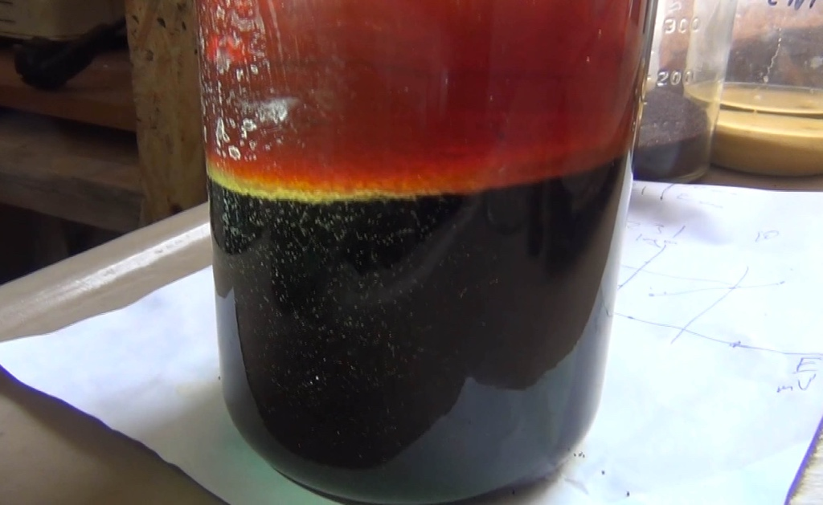
Desorption and Production Stage of Yellowcake (U₃O₈)
Laboratory process at the Institute of Nuclear Research (IIN) in Kara-Balta using anionite recovered from the sorption column at the Kamyshanovskoye deposit.
General Data
12

Slide 13
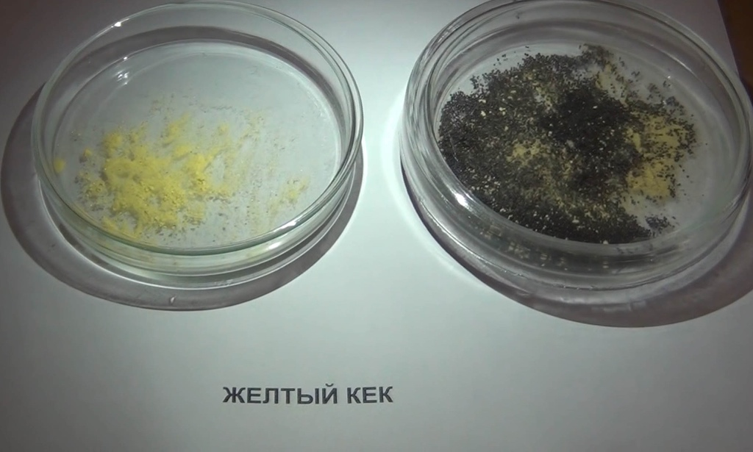
Yellowcake (Uranium Oxide, U₃O₈) Produced from the Kamyshanovskoye Deposit
Produced at the IIN Kara-Balta laboratory under the supervision of Professor L.I. Evteeva, November 2015.
General Data
13

Slide 14
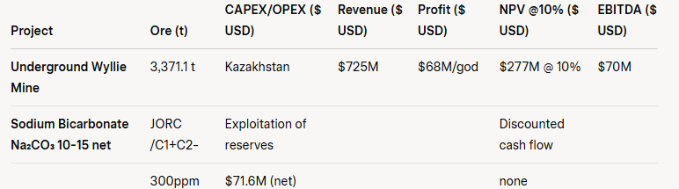
SUMMARY 
Kamyshanovskoye Uranium Deposit
Economic Model (Project)
Main product – U₃O₈
Uranium recovery – 80%
U₃O₈ price – $103/lb ($220/kg)
General Data
14

Slide 15
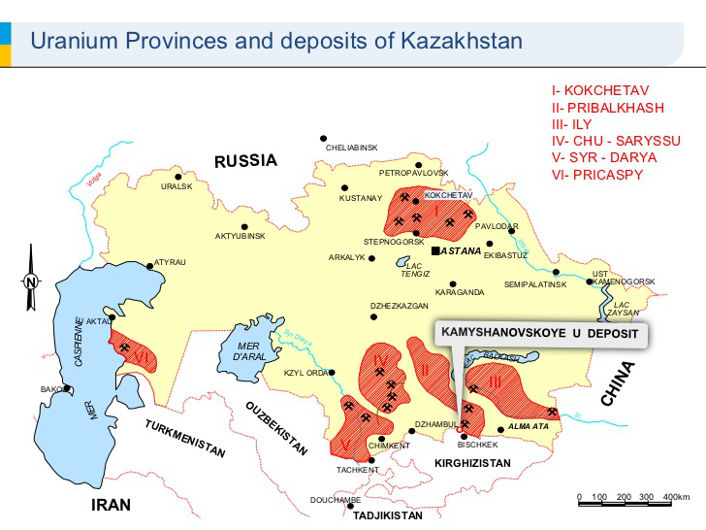
SUMMARY 
General Data
15

Slide 16
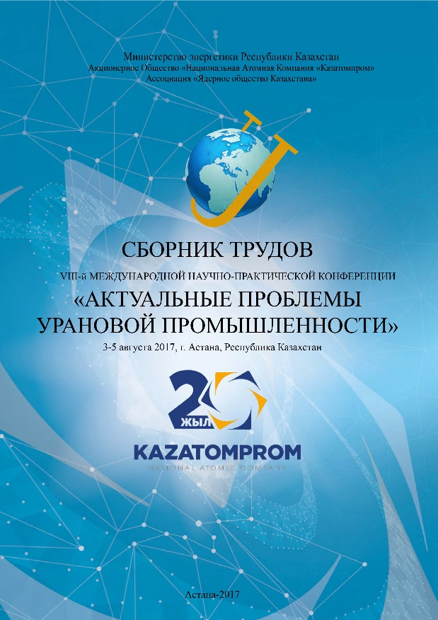
Presentation at the International Conference of Kazatomprom
In August 2017, at the VIII International Scientific and Practical Conference "Current Issues of the Uranium Industry" held in Astana, Republic of Kazakhstan, our company presented a report on the industrial experience of in-situ uranium recovery from uranium-bearing peat, a method applied for the first time worldwide by our company.
The report demonstrated the principle feasibility of applying this method to similar deposits.
Our company’s method of in-situ uranium leaching for development of the Kamyshanovskoye deposit was recognized as one of the most cost-effective mining approaches.
Contacts
16

Slide 17
Conclusion
The entire technological chain for uranium production via in-situ recovery (ISR) at the Kamyshanovskoye peat deposit was successfully tested and confirmed.
The ISR block (test site) design proposed by the project’s chief technologist N.V. Savenya (UGTK, Russia) proved effective and will be used during full-scale commercial mining.
Bi-carbonate leaching using soda solution (calcined technical soda) allows for uranium recovery of up to 95% in laboratory tests and up to 85% during pilot operations.
Anionite efficiently sorbs uranium from the productive solution, and after desorption, yellowcake (uranium oxide U₃O₈) is produced as the final commercial product.
Kamyshanovskoye is a proven, easily minable uranium deposit in Kyrgyzstan.
Mining can begin 9–12 months after the completion of project design.
Reserves registered with the State Committee for Reserves (GKZ):
3,371.1 tonnes of uranium, approved by GKZ protocol dated January 22, 2019.
Planned reserve increase to 5,000 tonnes of uranium.
The company received mining rights under License Commission Protocol No. 15-H-19 dated April 10, 2019.
Estimated mine life: 10–15 years
Annual production: 250–300 tonnes of uranium
(650,000–750,000 lbs of U₃O₈)
General Data
16

Slide 18
In 2018, IMC Invest entered into an option agreement with the publicly listed company MetalNRG (London, UK, listed on the LSE) for full financing of CAPEX/OPEX.
The project received full support from environmental organizations, as it involves the remediation of land and a water body from heavy metal contamination.
The company purchased and leased 20 hectares of land with utility buildings, where the leaching, sorption, storage, and technical support facilities for extraction operations will be located. This significantly simplifies land allocation and all infrastructure for pilot-scale production (PSP).
Law of the Kyrgyz Republic No. 139 dated December 14, 2019, prohibits uranium exploration and mining.
The company halted all operations in May 2019 and is currently in a force majeure status.
Based on the BIT agreements USA-Kyrgyzstan (1993), UK-Kyrgyzstan (1994), and the Law on Investment Protection, the company submitted a claim to the Government of the Kyrgyz Republic for compensation of damages and losses, and for an amicable resolution of the dispute.
The law firms Enyo Law (London, UK) represent the interests of IMC Invest (USA).
The Business Ombudsman of the Kyrgyz Republic reviewed the case and issued an opinion in favor of IMC Invest (August 2020).
General Data
18

Slide 19
In June 2024, the ban on uranium exploration and mining was lifted.
IMC Invest is finalizing arbitration proceedings and initiating negotiations for a settlement agreement and the issuance of a mining license.
Contacts
19

